Slide 1

ABSTRACT ART BUY AND SELL PLATFORM
DONE BY
TEAM LEAD
ABINESH.C
VARSHINI.G
PRIYADHARSHINI.S
KARSHANA B G
RACHEL NISSI.K

Slide 2
Abstract Art Buy and Sell Platform
This project aims to build a dedicated online platform where abstract art enthusiasts and creators can connect. Our platform enables artists to display their unique creations and sell them directly to interested buyers. This bridges the gap between creativity and commerce, offering a tailored experience for the niche yet vibrant abstract art community.

Slide 3
Introduction
Art has always been a profound medium of expression, and abstract art, in particular, transcends traditional boundaries with its non-representational style. However, there is a lack of dedicated platforms focusing solely on abstract art where artists can showcase their work and where buyers can explore and purchase such pieces. Our platform addresses this gap by creating a specialized digital marketplace designed exclusively for abstract art. It simplifies the process of displaying, discovering, and purchasing art while promoting emerging and established artists alike.

Slide 4
Project Objectives
The primary goal of this project is to create a seamless platform where abstract artists and buyers can interact. Key objectives include:
Enabling artists to create profiles, upload artworks, and set prices.
Allowing users to browse artwork by themes, colors, price ranges, and artist.
Facilitating secure transactions and providing a smooth checkout process.
Ensuring a responsive and intuitive interface to enhance user experience on both desktop and mobile devices.
Supporting community-building features such as reviews and likes.

Slide 5
Tools and Technologies Used
To build this platform efficiently, we employed modern web development technologies:
Frontend: React.js for a dynamic and responsive interface, along with HTML, CSS, and JavaScript.
Backend: Node.js with Express.js for creating RESTful APIs and handling server-side logic.
Database: MongoDB, a NoSQL database, to store user profiles, artwork data, and transaction details.
Authentication: JWT for secure login, with support for social logins via Google OAuth.
Cloud Services: Cloudinary/Firebase for storing and optimizing artwork images.
Payment Gateway: Stripe or Razorpay integration for secure online payments.
Version Control: Git and GitHub for collaboration and version tracking.
Hosting: Netlify or Vercel for frontend deployment and Heroku for the backend.

Slide 6
User Roles
Our platform supports three major types of users:
Artists: They can sign up, create a portfolio, and upload their abstract artworks along with descriptions and pricing. They have access to a dashboard to manage sales and track customer interactions.
Buyers: They can explore artwork using advanced filters, add desired items to their cart, and securely complete purchases. A wishlist feature allows saving favorite pieces.
Admins: Responsible for content moderation, user management, and platform analytics. They ensure the platform maintains quality and security standards.

Slide 7
Work Accomplished – Phase 1
In the first phase, we focused on ideation, planning, and basic development:
We conducted research to understand user requirements, pain points, and expectations from an abstract art marketplace.
Designed low-fidelity wireframes and high-fidelity UI prototypes using tools like Figma.
Developed the frontend structure, including pages such as Home, Gallery, Signup/Login, and Artist Profile.
Set up the MongoDB schema to store user data, artwork details, and transaction records.

Slide 8
Work Accomplished – Phase 2
During the second phase, we added key features and completed integration:
Implemented secure login/signup with password encryption and OAuth.
Integrated a payment gateway to facilitate real-time online purchases.
Enabled artwork uploads with file validations and image compression.
Designed the user dashboard for artists to view analytics, update artwork listings, and manage orders.
Ensured mobile responsiveness and cross-browser compatibility using responsive design principles.

Slide 9
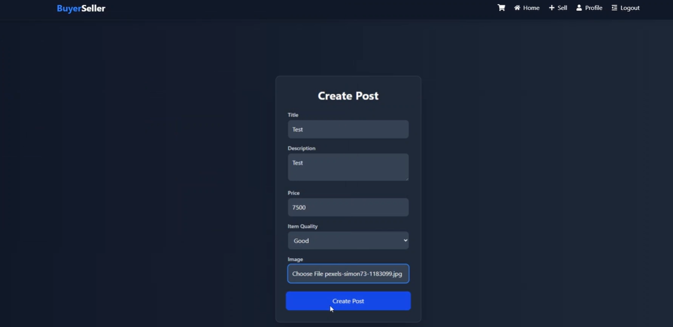
Screenshots of Our Platform
Home Page

Slide 10
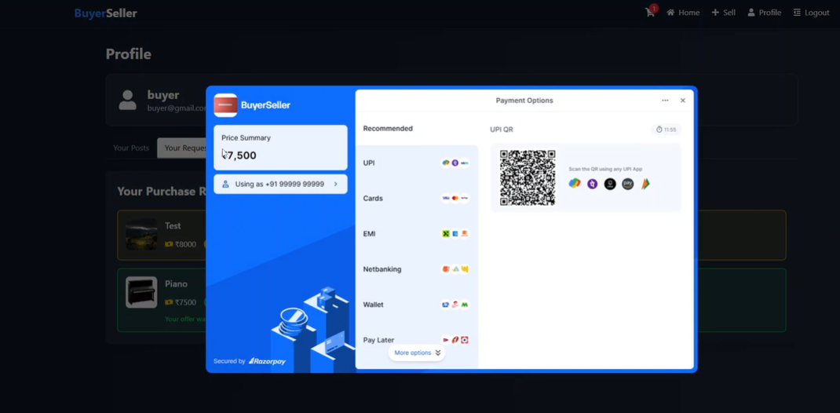
Screenshots of Our Platform
Gallery Page

Slide 11
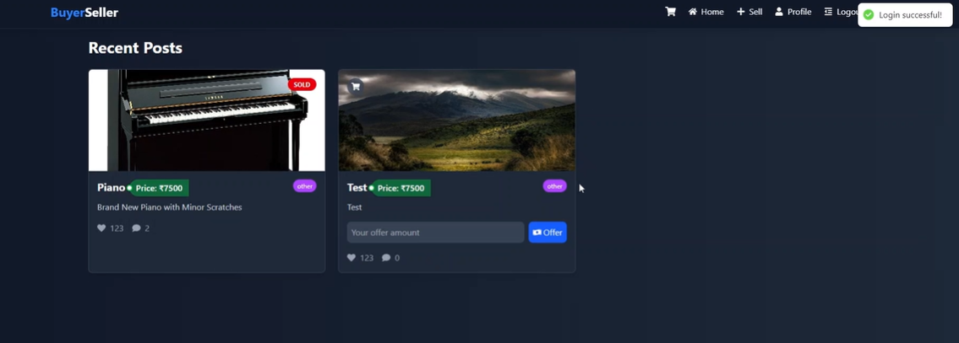
Screenshots of Our Platform
Artist Dashboard

Slide 12
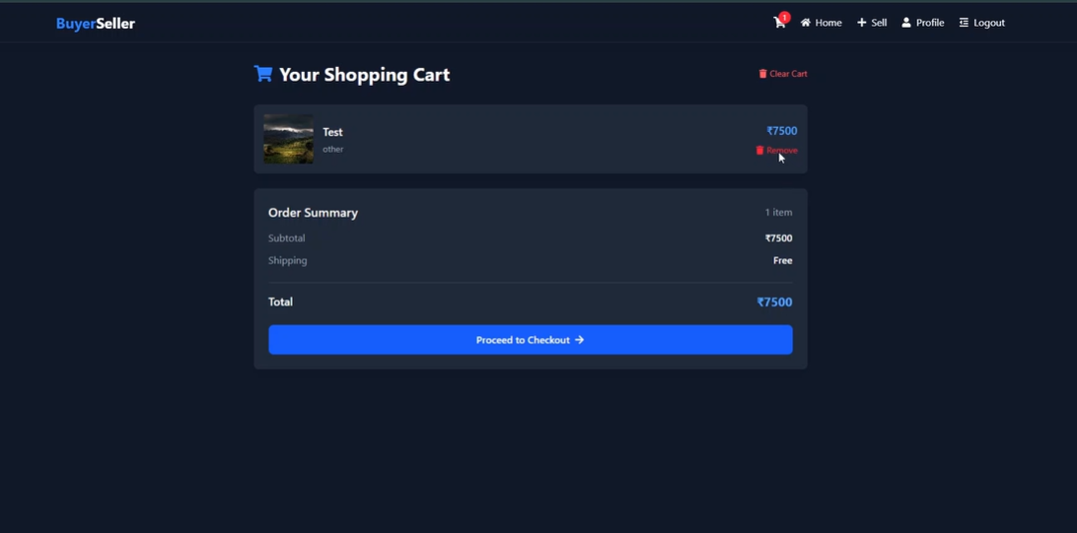
Screenshots of Our Platform
Checkout Flow

Slide 13
Outcomes
The platform successfully delivers a user-centric experience tailored to abstract art. It empowers artists by offering them visibility and direct access to customers. Buyers benefit from an easy and inspiring art discovery experience. With secure payment and account features, both parties are assured of safety and reliability. Overall, our solution presents a scalable foundation for a niche e-commerce platform that could be expanded with more features in the future.

Slide 14
Key Learnings
This project was a significant learning experience across several domains:
We gained practical knowledge of full-stack development using the MERN stack.
We understood how to handle image uploads, media optimization, and cloud integration.
We learned to implement secure authentication and protect user data.
The team improved collaboration skills using Git for version control.
We explored the nuances of UI/UX design and its impact on user retention and satisfaction.
Working on real-time transactions deepened our understanding of e-commerce and data integrity.

Slide 15
Our Website
Our platform is live and accessible to anyone interested in exploring or purchasing abstract art. Users can register as artists or buyers and begin interacting with the platform's features.
Demo Video: "C:\Users\HP\Downloads\Demo video.mp4"

Slide 16
GitHub Repository
We’ve maintained well-documented codebases for both the frontend and backend:
Frontend Repository: https://github.com/URK21CS1175/Art-Buy-and-Seller-_Platform
Backend Repository: https://github.com/URK21CS1175/Art-Buy-and-Seller-_Platform
These repositories reflect our structured development process and include installation guides for local deployment. Contributions are welcome for future improvements.

Slide 17
THANK YOU!

